Slide 1


Customer Churn Analysis
Power BI

Slide 2

Agenda
  Project Overview
  Data Source
  Data Preparation
  Dashboard Visualizations
  Applications & Recommendations
  Conclusion
  Any Queries

Slide 3
Project Overview
  Analyze customer churn patterns to understand why customers discontinue services and identify the major drivers of attrition.
  Understand customer behavior using demographic factors, service subscriptions, usage patterns, and billing information.
  Measure churn rate across customer segments such as tenure groups, contract type, internet service, and payment method to identify high-risk categories.
  Visualize business performance using interactive Power BI dashboards, KPIs, and drill-down reports for deeper insights.
  Predict high-risk customers by analyzing behavior, payment trends, and service engagement to support targeted retention strategies.
  Enable data-driven decision-making that helps reduce churn, improve customer satisfaction, and enhance long-term revenue stability.

Slide 4
Data Source
  Dataset Name: Telco Customer Churn Dataset
  Source: Kaggle
  File Type: Excel file
  Total Records: 7,043 customers
  Total Columns: 21 fields

Slide 5
Data Preparation
  Imported dataset into Power BI Desktop from Excel file.
  Performed data cleaning using Power Query Editor to ensure accuracy and consistency.
  Checked and removed null values in columns like TotalCharges and replaced blanks where necessary.
  Converted TotalCharges from text to numeric.
  Ensured SeniorCitizen, Churn, and Partner were properly categorized as Yes/No or binary fields.
  Created calculated columns and DAX measures for:
  Churn Rate, Average Monthly Charges, Average Tenure, Total Revenue
  Standardized categorical values ( No internet service changed to No for clarity).
  Added new derived fields for advanced analysis such as:
  Total Services Subscribed (count of services per customer)
  Validated the dataset to ensure no duplicates or mismatched entries.
  Loaded the cleaned data into the Power BI Model for visualization and analysis.

Slide 6
Dashboard Visualizations
1. Customer Demographics Dashboard
  Visuals Used:
  Stacked column chart →Sum of monthly charges by gender and payment method
  Donut Chart →Total customers by gender
  Bar Chart → Sum of Senior citizen by churn
  Column Chart → sum of total charges by gender
  Clustered column chart → Average of MonthlyCharges and Max of tenure by Streaming Movies
  Line Chart → Average of Monthly Charges by tenure
  Stacked column chart → Sum of tenure by InternetService and Contract
  Cards → Total Customers, Sum of total charges,Avg. Tenure, Sum of Monthly Charges
  Slicers →Gender,Contract,Partner
  Purpose: Understand customer profile and churn behavior by demographics.

Slide 7
Dashboard Visualizations
2. Service Subscription Dashboard
  Visuals Used:
  Column Chart → Total customers by Phone Service
  Water fall chart →churn ratio by StreamingMovies
  Area Chart→ Churn rate by Internet service
  Ribbon chart → total customers by PaymentMethod and InternetService
  Stacked column chart → Total customers and Sum of TotalCharges by OnlineSecurity and Churn
  Stacked column chart → Total customers by Churn and PhoneService
  Cards →Churn rate,total customers,Sum of senior citizens,Churned customers
  Slicers → Gender, Internet Service, Contract Type
  Purpose: Identify which services and combinations impact churn the most.

Slide 8
Dashboard Visualizations
3. Contract & Billing Dashboard
  Visuals Used:
  Ribbon Chart → Churned Customers by PaperlessBilling
  Column Chart → Sum of tenure by Contract
  Donut Chart → Sum of Total Charges by Contract
  Stacked bar Chart → Sum of tenure by Churn and Payment
  Pie chart → Churn rate by Contract
  Cards → Average of total charges Charges, Churn Rate, Total Customers
  Slicers → Payment method,Contract
  Purpose: Analyze billing behavior and contractual patterns influencing churn.

Slide 9
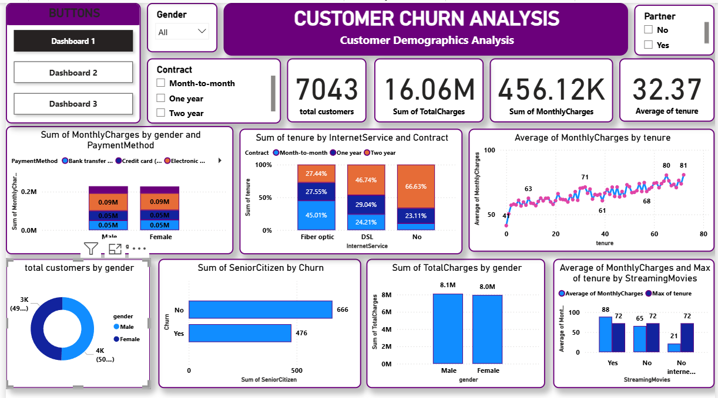

Slide 10
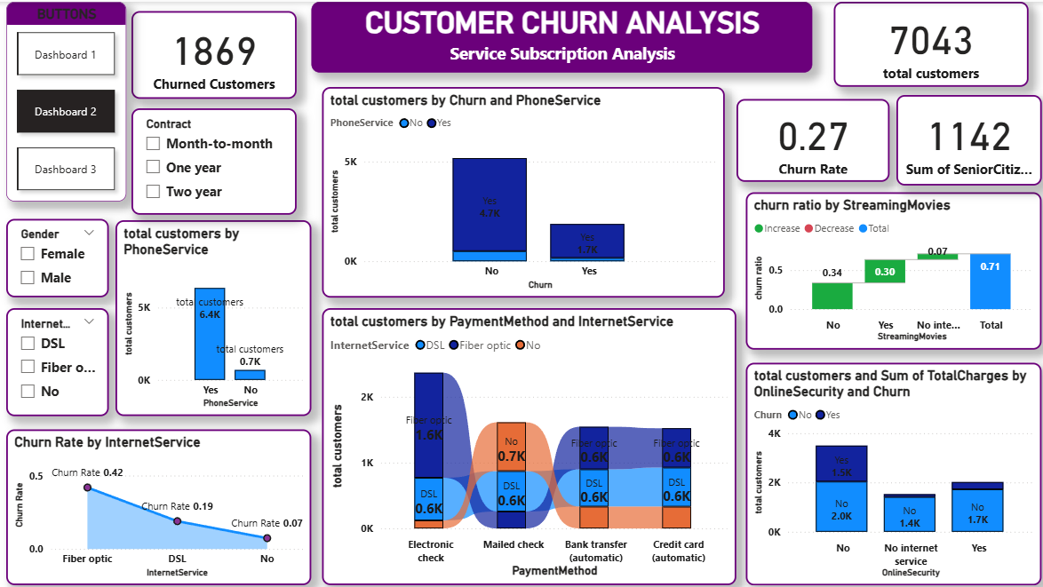

Slide 11
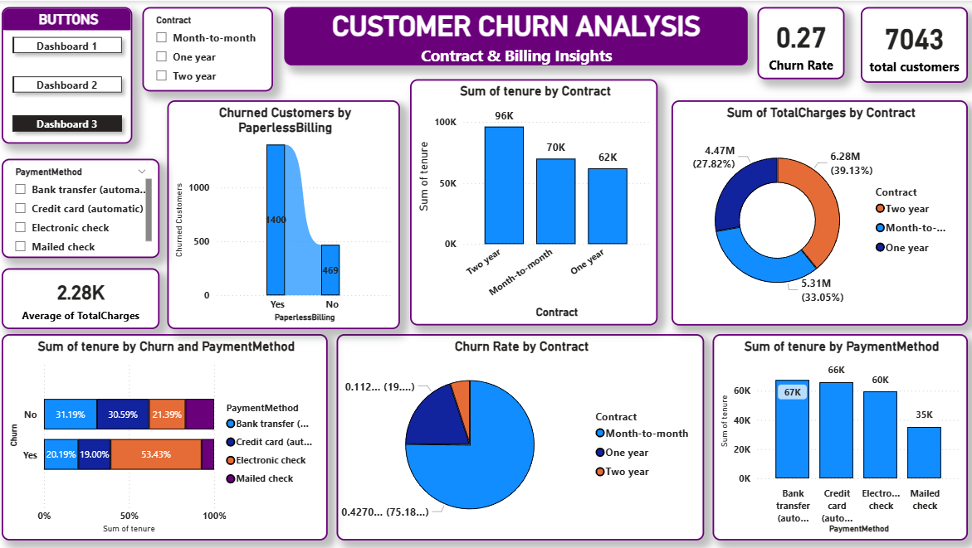

Slide 12
Applications & Recommendations
Applications
  Used by Marketing Teams to identify and target high-risk customers with retention offers.
  Helps Customer Support prioritize service improvement for segments with high churn.
  Enables Management to track key churn KPIs and make data-driven strategic decisions.
  Supports Product Teams in optimizing service bundles and pricing models.
Recommendations
  Encourage long-term contracts (1-year or 2-year plans) through discounts and loyalty rewards.
  Promote bundled service packages (e.g., Internet + Streaming + Security) to reduce churn.
  Improve customer retention by offering personalized plans for senior citizens and high-charge users.
  Educate customers about benefits of online backup and device protection services, as these reduce churn.
  Monitor monthly charges and payment issues closely for early churn indicators.

Slide 13
Conclusion
  The Power BI dashboards provided clear visibility into customer churn behavior and patterns.
  Analysis revealed that high monthly charges, month-to-month contracts, and fiber optic services are major churn drivers.
  Customers with longer tenure and multiple service subscriptions show greater loyalty and lower churn.
  Demographic factors such as senior citizen status and partner/dependent presence also influence churn tendency.
  The insights enable the company to design targeted retention strategies and reduce customer loss.
  Implementing data-driven actions can help boost customer satisfaction, increase retention rate, and maximize revenue.
  Overall, the project demonstrates how Power BI transforms raw data into actionable business insights for strategic decision-making.

Slide 14
ANY
Queries?

Slide 15

THANK YOU

